Slide 1
Why Python?

Slide 2
Python is General Purpose Language

Slide 3
FEATURES
EASY
EXTENSIBLE
EXPRESSIVE
EMBEDDABLE
FREE AND OPEN SOURCE
INTERPRETED
HIGH-LEVEL
LARGE STANDARD LIBRARY
GUI PROGRAMMING
PORTABLE
OBJECT ORIENTED
DYNAMICALLY TYPED

Slide 4
Python is High Level Programming Language

Slide 5
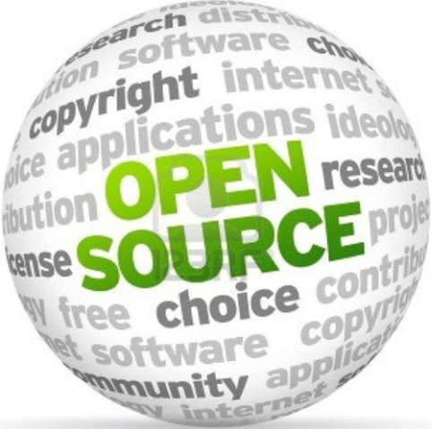
Python
is OpenSource

Slide 6
Python is Object Oriented

Slide 7
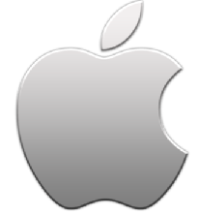
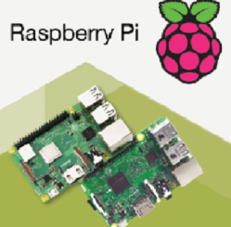
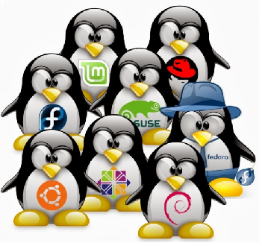
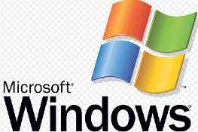
Python
is Portable

Slide 8
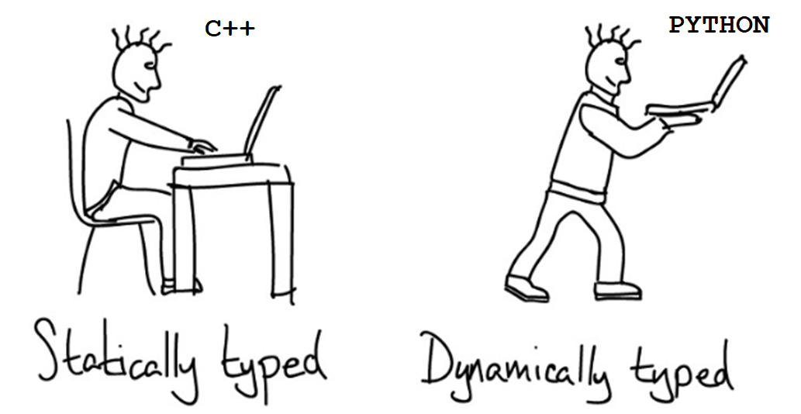

Slide 9
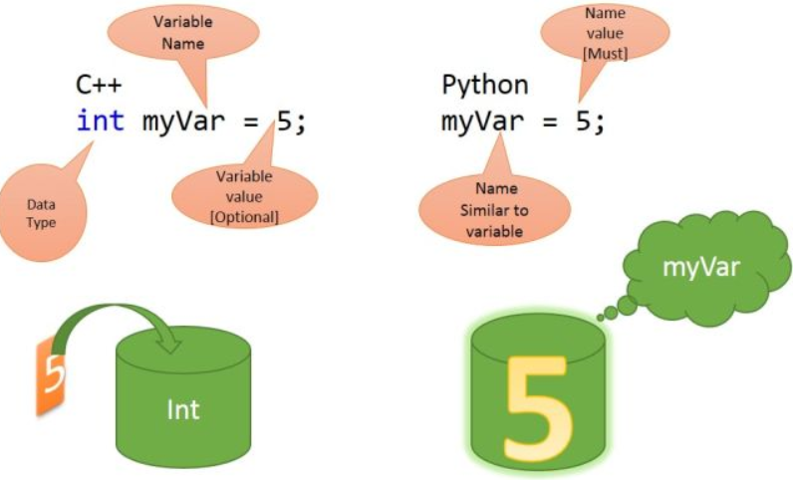
Python is Dynamically Typed Language

Slide 10
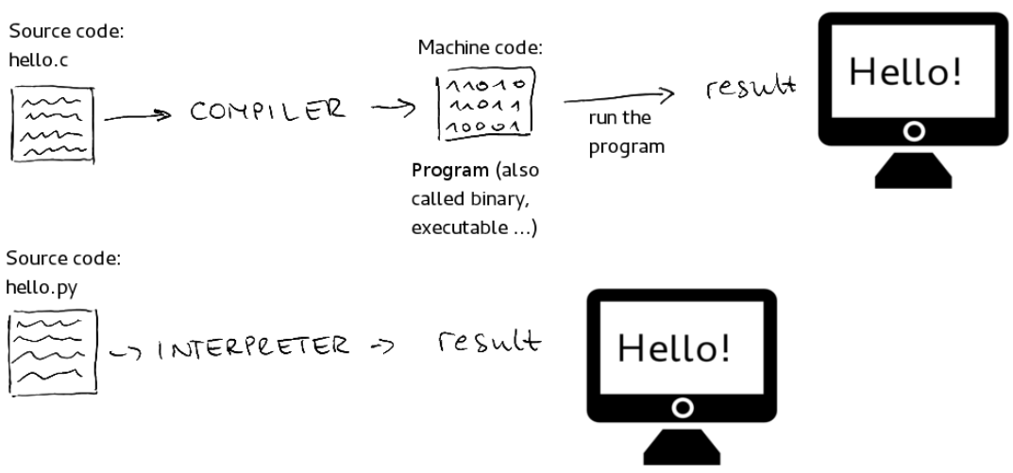
Python is Interpreted Language

Slide 11
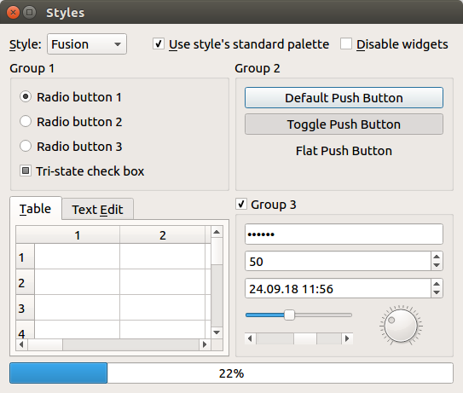
Python used for
Creating
GUI

Slide 12
MODULES
Python has large
standard
library
Created by You
Eg: myFristPrg.py
External Sources
Eg: PyPi
Preinstalled
Eg: math,random
Standard Library
pypi.org
Collection of Modules

Slide 13
Python Program
------------------------
-------------------------
C Code
------------------------
-------------------------
Python is Extensible
Piece of Code in C or Java

Slide 14
Python is Embeddable
Your C/C++ Program
Cpython Interpreter
Cpython Interpreter
myscript.py

Slide 15
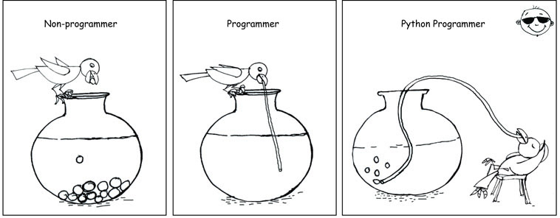

Slide 16
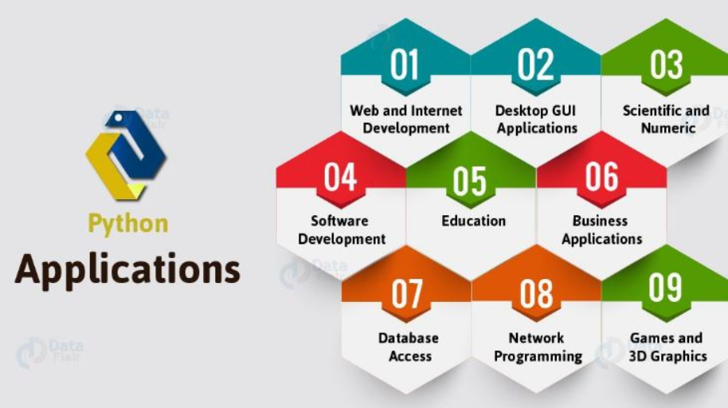

Slide 17
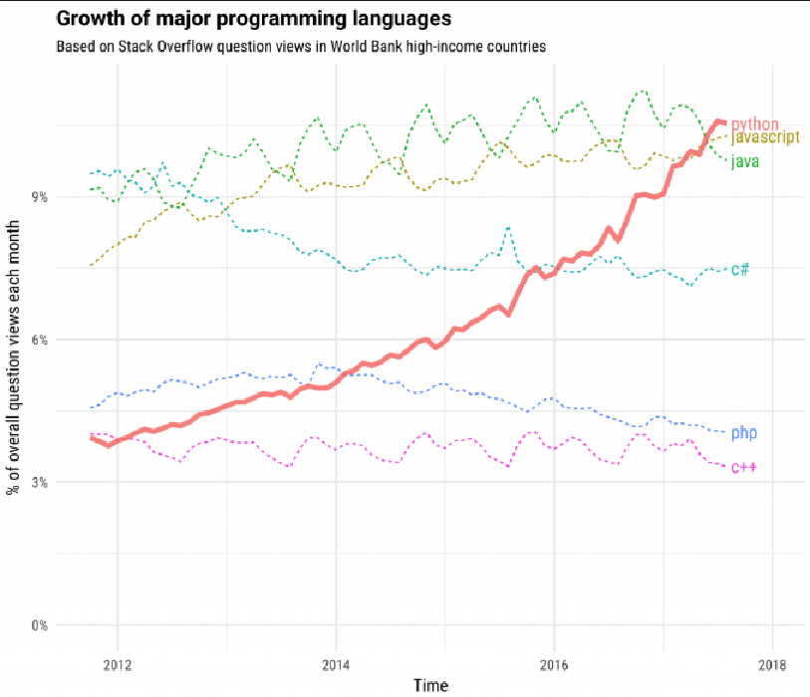
Popularity of Python

Slide 18
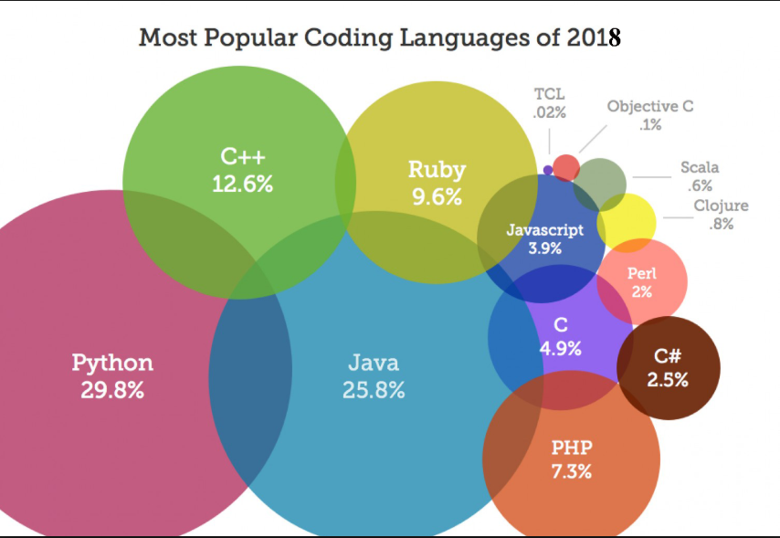

Slide 19
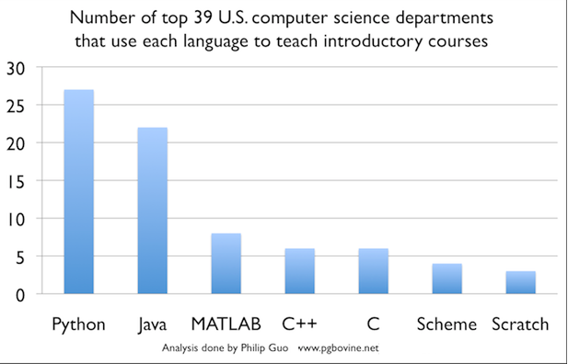

Slide 20
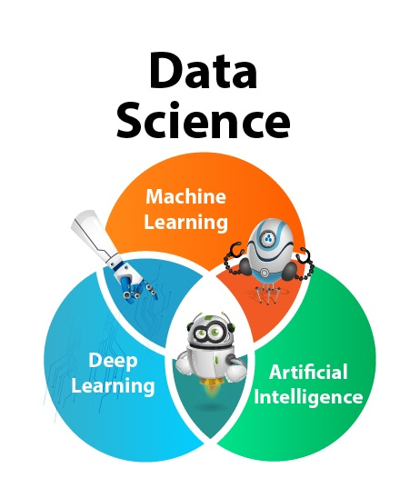
Data Scientists Love Python

Slide 21
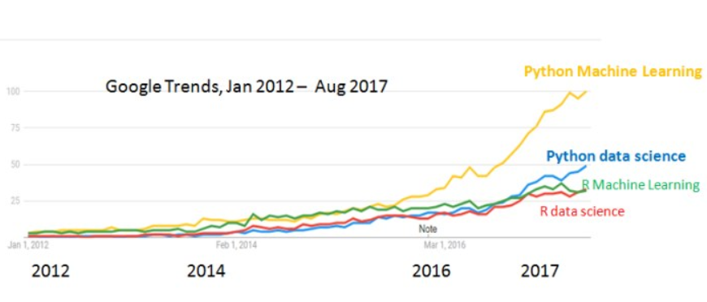
Who is ahead in Data Sciences?

Slide 22
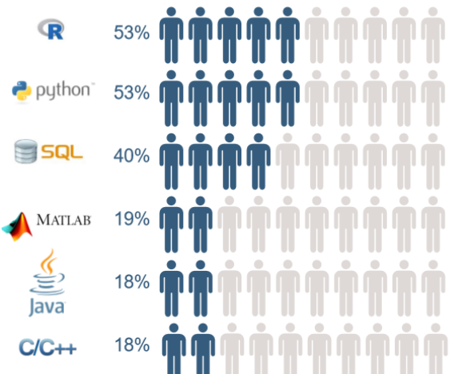
Skills required to become a data scientist

Slide 23
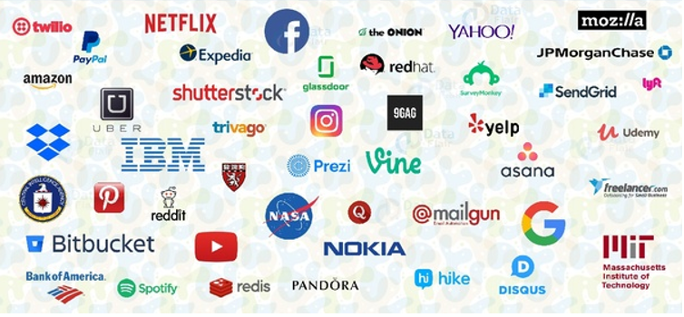
List of few companies who are using Python

Slide 24
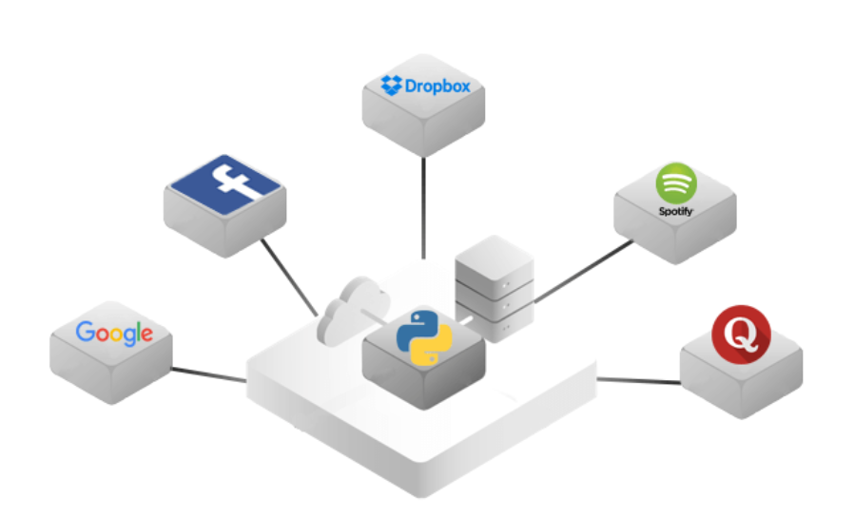
Top Companies that built their websites with Python Framework

Slide 25
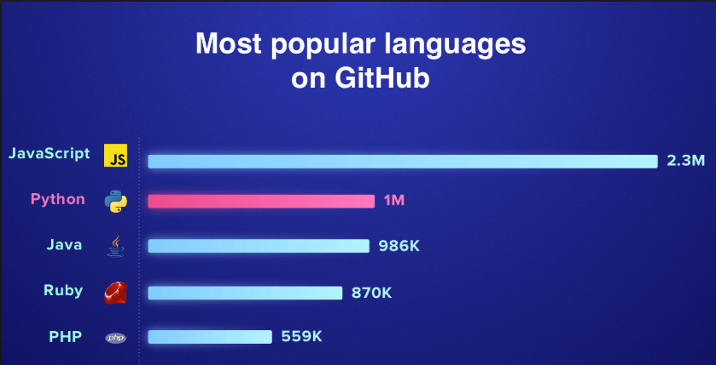
Most Popular Languages on GitHub

Slide 26
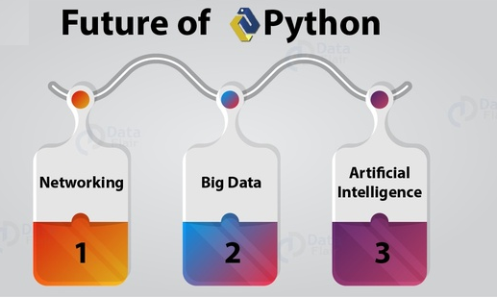
Technologies that rely on Python Today and Tomorrow

Slide 27
Python was created in 1991

Slide 28

Who created Python?
Guido van Rossum
Benevolent Dictator for Life (BDFL)
- Python Software Foundation.

Slide 29
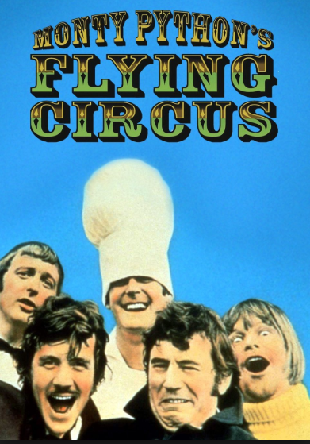
Why is it called Python?

